Slide 1

Introduction to NoSQL databases and CAP theorem
Database Management System | Storage Structures, Indexing and Query Optimization
Course: Database Management System | Chapter: Storage Structures, Indexing and Query Optimization | Program: B.TECH-CSE, B.TECH CSE - CYBER SECURITY, B.TECH CSE - DATA
DISCOVER · LEARN · EMPOWER
Notes:
Welcome everyone to this advanced session on storage structures. Today we bridge the gap between traditional indexing and modern NoSQL architectures. We will explore how CAP theorem dictates our storage choices for scalability. Remember, the goal is to empower you with critical analysis skills.

Slide 2
Course Outcomes
SLIDE 2 / 14
Course Outcome
CO | BT LEVEL | DESCRIPTION
CO1 | BT2 | Explain database architecture, relational model concepts and formal query language foundations including relational algebra and relational calculus.
CO2 | BT3 | Apply relational algebra, relational calculus and SQL constructs to formulate correct and efficient database queries.
CO3 | BT4 | Analyze functional dependencies and design normalized relational schemas up to 5NF ensuring lossless join and dependency preservation.
CO4 | BT4 | Analyze transaction schedules and concurrency control mechanisms to determine serializability, recoverability and correctness.
CO5 | BT5 | Evaluate storage structures, indexing strategies and query optimization techniques for performance, scalability and reliability.
Chandigarh University
2 / 14
Notes:
These outcomes define our success criteria for this lecture. CO4 ensures you can analyze how NoSQL handles transactions differently than SQL. CO5 requires you to evaluate storage structures for scalability, which is the core of NoSQL design. We will apply these outcomes to real-world distributed systems.

Slide 3
Learning Objectives
SLIDE 3 / 14
Learning Outcomes
1
Analyze the fundamental differences between relational and NoSQL storage structures.
2
Evaluate the CAP theorem constraints for distributed database design decisions.
3
Classify NoSQL databases based on their consistency and availability trade-offs.
4
Apply the CAP theorem to select optimal storage strategies for specific workloads.
5
Critique query optimization techniques in the absence of traditional indexing structures.
Chandigarh University
3 / 14
Notes:
By the end of this session, you will analyze why traditional B-trees fail in distributed environments. You will evaluate how the CAP theorem forces architects to choose between consistency and availability. We will classify databases like Cassandra or MongoDB based on these theoretical constraints. Finally, you will critique how query optimization changes when indexes are optional.

Slide 4
Motivation
SLIDE 4 / 14
Limitations of Relational Storage
1
Relational storage relies on rigid schemas that hinder horizontal scaling capabilities.
2
Traditional B-tree indexing becomes inefficient when data spans multiple physical nodes.
3
ACID transactions in distributed systems introduce significant latency and complexity overhead.
4
Vertical scaling hits a physical ceiling requiring expensive hardware upgrades.
5
NoSQL storage structures prioritize flexibility and partition tolerance over strict schemas.
Chandigarh University
4 / 14
Notes:
Consider a social media platform with billions of users; a single relational server cannot handle the load. Traditional B-trees require locking mechanisms that slow down writes across distributed nodes. This creates a bottleneck where query optimization becomes impossible without massive hardware costs. NoSQL storage structures solve this by relaxing schema constraints to enable horizontal scaling.

Slide 5
Lecture
SLIDE 5 / 14
The CAP Theorem Fundamentals
1
CAP theorem states a distributed system can only guarantee two of three properties.
2
Consistency ensures every read receives the most recent write or an error.
3
Availability guarantees every request receives a non-error response without delay.
4
Partition tolerance ensures the system operates despite network failures between nodes.
5
Architects must choose between CP (Consistency + Partition tolerance) or AP (Availability + Partition tolerance).
Chandigarh University
5 / 14
Notes:
The CAP theorem is the cornerstone of distributed storage design. You cannot have all three simultaneously in a networked environment. If a network partition occurs, you must choose between serving stale data (Availability) or refusing service (Consistency). This trade-off fundamentally changes how we design storage structures for modern applications.

Slide 6

CP Systems
SLIDE 6 / 14
Consistency and Partition Tolerance
1
CP systems prioritize data accuracy over immediate availability during network partitions.
2
The system returns an error or timeout if a node cannot be reached.
3
Examples include HBase and MongoDB configured for strong consistency.
4
Query optimization focuses on ensuring data integrity before returning results.
5
These systems are ideal for financial transactions requiring strict serializability.
Source: s3.amazonaws.com
Chandigarh University
6 / 14
Notes:
In a CP system, if a network partition isolates a node, the system refuses to serve data to prevent inconsistency. This is crucial for banking applications where a wrong balance is unacceptable. You sacrifice availability to ensure that every read reflects the most recent committed write. This aligns with CO4's focus on transaction correctness and recoverability.

Slide 7
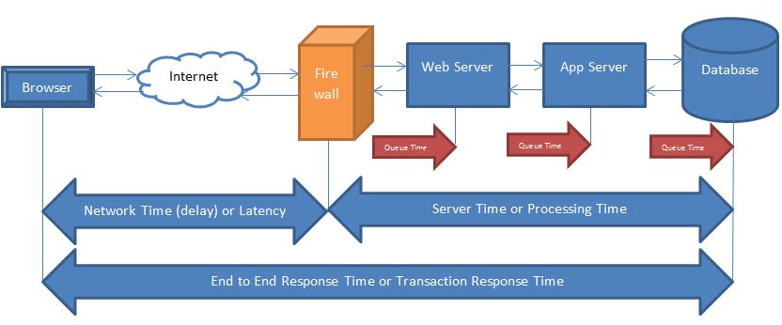
AP Systems
SLIDE 7 / 14
Availability and Partition Tolerance
1
AP systems prioritize uptime and responsiveness over immediate data consistency.
2
The system serves the most recent available data, which may be stale.
3
Examples include Cassandra and DynamoDB in default configurations.
4
Query optimization focuses on speed rather than strict data synchronization.
5
These systems are ideal for social media feeds and caching layers.
Source: perfmatrix.com
Chandigarh University
7 / 14
Notes:
In an AP system, the database serves data even if it might be slightly outdated. This ensures the application remains responsive during network failures. For a social media feed, seeing a post a few seconds late is acceptable for the sake of uptime. This approach supports CO5's requirement for evaluating scalability and reliability in high-traffic scenarios.

Slide 8
Worked Example
SLIDE 8 / 14
CAP Trade-off Calculation
GOVERNING EQUATION
CP Strategy: System blocks writes to maintain consistency, latency = 500ms
SCENARIO
A distributed system with 3 nodes and a network partition.
AP STRATEGY
System accepts writes locally, latency = 50ms, eventual consistency.
FORMULA
Latency_CP = Latency_base + Sync_Time vs Latency_AP = Latency_base.
RESULT
AP reduces latency by 90% but risks temporary data divergence.
Chandigarh University
8 / 14
Notes:
Let's calculate the impact of this choice. In a CP system, the system waits for synchronization, adding 500ms to the latency. In an AP system, the write is accepted immediately, adding only 50ms. This 90% reduction in latency comes at the cost of temporary inconsistency. This numerical example illustrates the tangible performance trade-offs in storage structure design.

Slide 9
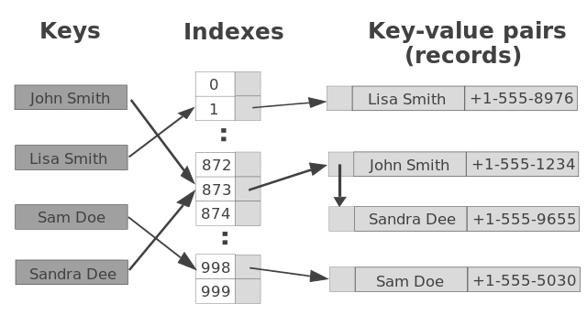
NoSQL Storage Structures
SLIDE 9 / 14
Key-Value Stores
1
Key-value stores use hash tables for O(1) average time complexity lookups.
2
Data is stored as opaque blobs without internal structure or indexing.
3
Query optimization is limited to exact key matches only.
4
Examples include Redis and DynamoDB for high-speed caching applications.
5
Scalability is achieved through simple partitioning based on hash keys.
Source: yourbasic.org
Chandigarh University
9 / 14
Notes:
Key-value stores are the simplest storage structure, using hash tables for instant access. They lack the complex indexing of relational databases, making them incredibly fast for specific lookups. Query optimization here is trivial because you only search by the primary key. This structure is perfect for session storage or caching where speed is paramount.

Slide 10
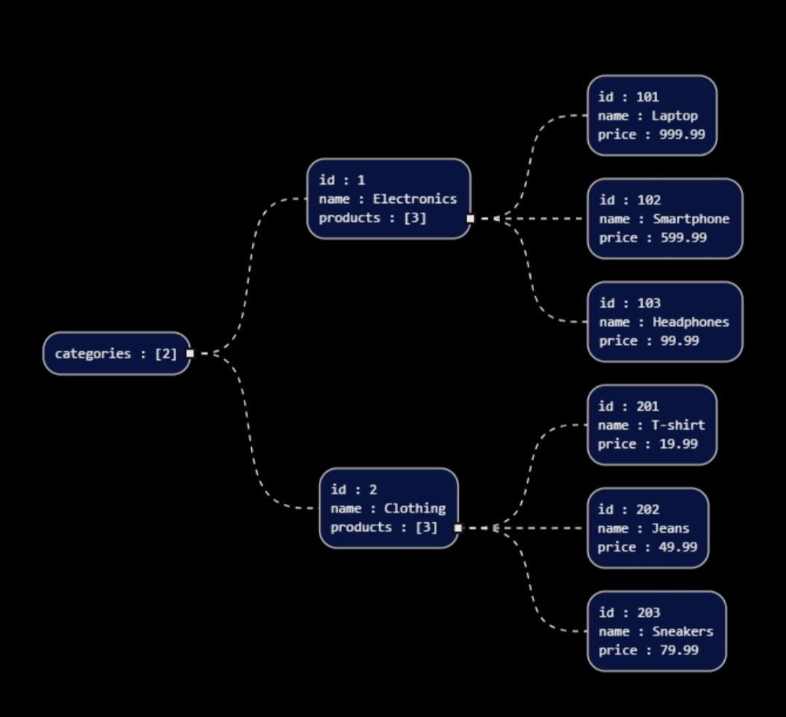
NoSQL Storage Structures
SLIDE 10 / 14
Document Stores
1
Document stores store data as JSON-like documents with flexible schemas.
2
Indexing can be applied to specific fields within the document structure.
3
Query optimization supports complex queries on nested attributes and arrays.
4
Examples include MongoDB and Couchbase for content management systems.
5
Scalability is achieved through sharding based on document identifiers.
Source: ik.imagekit.io
Chandigarh University
10 / 14
Notes:
Document stores offer a middle ground, allowing flexible schemas with field-level indexing. You can optimize queries on specific attributes like 'user_age' or 'product_category'. This flexibility supports CO5's requirement for evaluating indexing strategies for performance. However, the lack of joins requires denormalization, which impacts storage efficiency.

Slide 11
NoSQL Storage Structures
SLIDE 11 / 14
Column-Family Stores
1
Column-family stores organize data by columns rather than rows for efficiency.
2
Indexing is optimized for scanning large datasets across specific columns.
3
Query optimization excels in analytical workloads and time-series data.
4
Examples include Apache Cassandra and HBase for massive scale analytics.
5
Scalability is achieved through distributed column families across many nodes.
Chandigarh University
11 / 14
Notes:
Column-family stores are designed for massive scale and analytical queries. They store data by column, which allows for highly efficient compression and scanning. Query optimization here focuses on reading specific columns across millions of rows. This structure is ideal for IoT data or log analysis where you read specific attributes frequently.

Slide 12
Lecture
SLIDE 12 / 14
Query Optimization in NoSQL Environments
1
Traditional B-tree indexing is often replaced by hash or LSM-tree structures.
2
Query optimization relies on denormalization to avoid expensive join operations.
3
Read-heavy workloads benefit from materialized views and pre-computed aggregates.
4
Write-heavy workloads use log-structured merge trees for high throughput.
5
Optimization strategies must align with the chosen CAP theorem trade-off.
Chandigarh University
12 / 14
Notes:
In NoSQL, we often denormalize data to avoid joins, which are expensive in distributed systems. Query optimization shifts from index tuning to data modeling strategies. For write-heavy systems, we use LSM-trees to batch writes efficiently. This approach directly addresses CO5's focus on evaluating indexing strategies for performance and scalability.

Slide 13
Lecture
SLIDE 13 / 14
Key Takeaways
1
CAP theorem forces a choice between consistency and availability in distributed systems.
2
NoSQL storage structures prioritize scalability and flexibility over rigid relational schemas.
3
CP systems ensure data accuracy but sacrifice availability during network partitions.
4
AP systems ensure uptime but may serve stale data temporarily.
5
Query optimization in NoSQL relies on denormalization and specialized indexing.
Chandigarh University
13 / 14
Notes:
To summarize, the CAP theorem is the fundamental constraint guiding your storage design. You must choose between CP and AP based on your application's needs. NoSQL structures offer flexibility but require a shift in how we model and optimize queries. Remember, there is no one-size-fits-all solution in distributed storage.

Slide 14
Lecture
SLIDE 14 / 14
References
1
Fundamentals of Database Systems — Ramez Elmasri & Shamkant B. Navathe
2
Database System Concepts — Silberschatz, Korth & Sudarshan
3
Database Management Systems — Raghu Ramakrishnan & Johannes Gehrke
4
Oracle/MySQL Documentation — Oracle
Chandigarh University
14 / 14
Notes:
These references provide the theoretical foundation for the concepts discussed today. Elmasri and Navathe offer deep insights into database fundamentals. Silberschatz and Ramakrishnan provide detailed coverage of storage structures and optimization. Please consult the Oracle documentation for practical implementation details of NoSQL systems.

